Slide 1
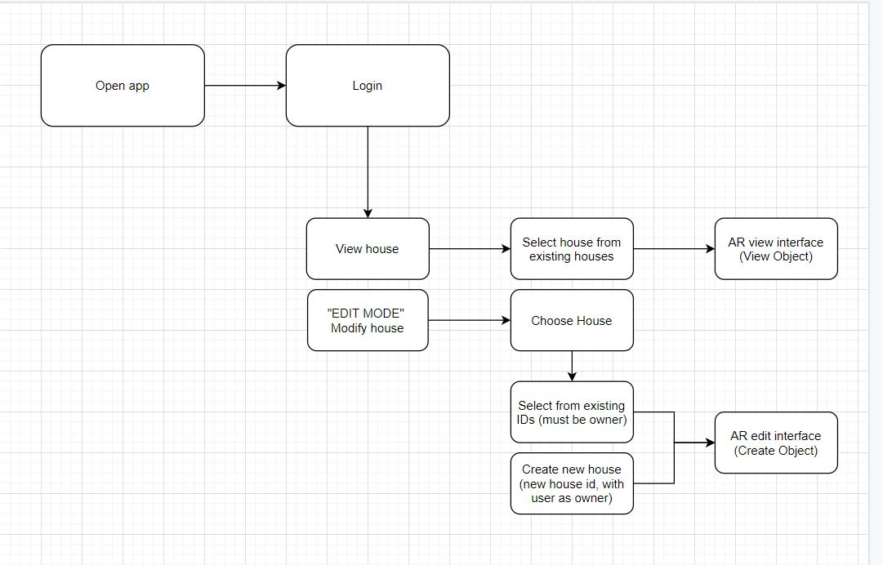
Fall 2020 COM S Senior Design – ARBnb
NAMES - Andrew Phares
Project Description
Module Interface Descriptions
User Interfaces
Design Decisions
Block Diagram:

